Slide 1

JavaScript
Guided By:-
Mr. Lalit Purohit
Mr. Upendra Singh
Presented By:-
Manya Mishra (IT 50)
Nitesh Dhakad (IT 56)

Slide 2
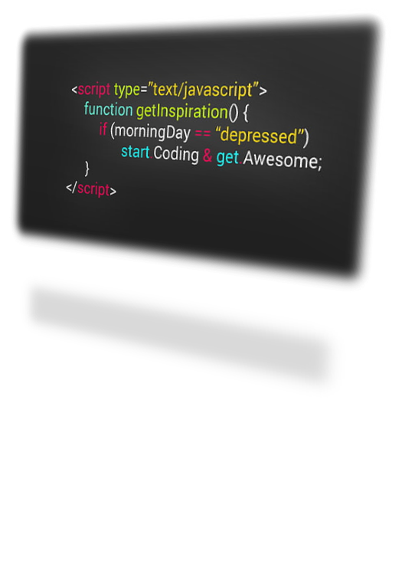
Introduction To Javascript
JavaScript is a lightweight, cross-platform, single-threaded, and interpreted compiled programming language. It is also known as the scripting language for webpages. It is well-known for the development of web pages, and many non-browser environments also use it.

Slide 3
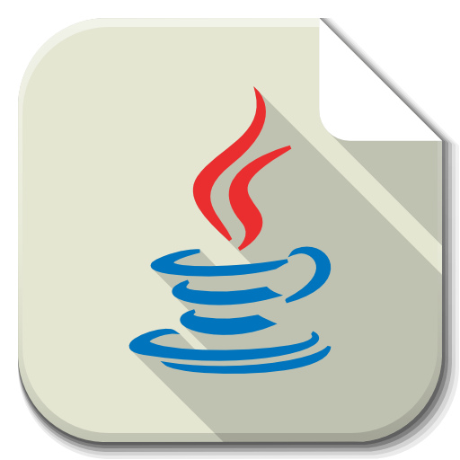

About JavaScript

Slide 4
Using JavaScript in a browser
JavaScript code is included within <script> tags:
  <script type="text/javascript">
  document.write("<h1>Hello World!</h1>") ;
  </script>
Notes:
  The type attribute is to allow you to use other scripting languages (but JavaScript is the default)
  This simple code does the same thing as just putting <h1>Hello World!</h1> in the same place in the HTML document
  The semicolon at the end of the JavaScript statement is optional
    You need semicolons if you put two or more statements on the same line
    It’s probably a good idea to keep using semicolons

Slide 5
Where to put JavaScript
JavaScript can be put in the <head> or in the <body> of an HTML document
  JavaScript functions should be defined in the <head>
    This ensures that the function is loaded before it is needed
  JavaScript in the <body> will be executed as the page loads
JavaScript can be put in a separate .js file
  <script src="myJavaScriptFile.js"></script>
  Put this HTML wherever you would put the actual JavaScript code
  An external .js file lets you use the same JavaScript on multiple HTML pages
  The external .js file cannot itself contain a <script> tag
JavaScript can be put in HTML form object, such as a button
  This JavaScript will be executed when the form object is used

Slide 6
Primitive data types
JavaScript has three “primitive” types: number, string, and boolean
  Everything else is an object
Numbers are always stored as floating-point values
  Hexadecimal numbers begin with 0x
  Some platforms treat 0123 as octal, others treat it as decimal
Strings may be enclosed in single quotes or double quotes
  Strings can contains \n (newline), \" (double quote), etc.
Booleans are either true or false
  0, "0", empty strings, undefined, null, and NaN are false , other values are true

Slide 7
Variables
Variables are declared with a var statement:
  var pi = 3.1416, x, y, name = "Dr. Dave" ;
  Variables names must begin with a letter or underscore
  Variable names are case-sensitive
  Variables are untyped (they can hold values of any type)
  The word var is optional (but it’s good style to use it)
Variables declared within a function are local to that function (accessible only within that function)
Variables declared outside a function are global (accessible from anywhere on the page)

Slide 8
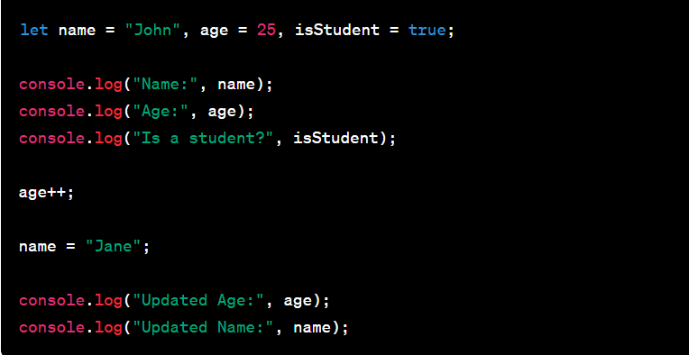

Slide 9
Operators, I
Because most JavaScript syntax is borrowed from C (and is therefore just like Java), we won’t spend much time on it
Arithmetic operators:
+ - * / % ++ --
Comparison operators:
< <= == != >= >
Logical operators:
&& || ! (&& and || are short-circuit operators)
Bitwise operators:
& | ^ ~ << >> >>>
Assignment operators:
+= -= *= /= %= <<= >>= >>>= &= ^= |=

Slide 10
Operators, II
String operator:
+
The conditional operator:
condition ? value_if_true : value_if_false
Special equality tests:
  == and != try to convert their operands to the same type before performing the test
  === and !== consider their operands unequal if they are of different types
Additional operators (to be discussed):
new typeof void delete

Slide 11
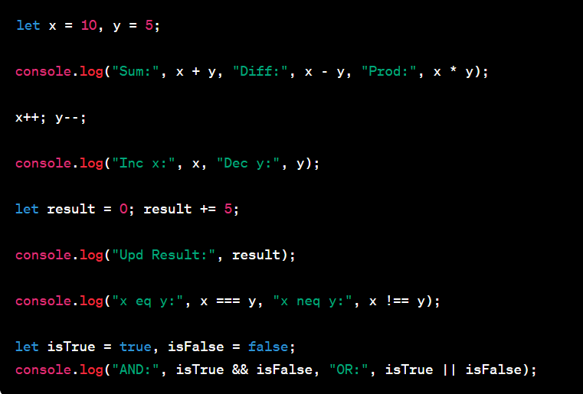

Slide 12
Comments
Comments are as in C or Java:
  Between // and the end of the line
  Between /* and */
Java’s javadoc comments, /** ... */, are treated just the same as /* ... */ comments; they have no special meaning in JavaScript

Slide 13
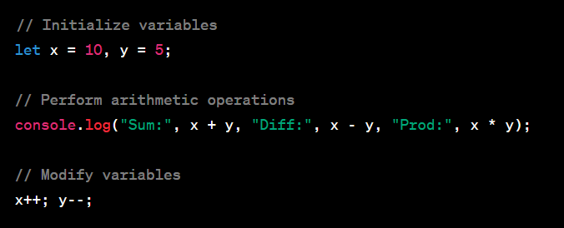

Slide 14
Statements, I
Most JavaScript statements are also borrowed from C
  Assignment: greeting = "Hello, " + name;
  Compound statement:
  { statement; ...; statement }
  If statements:
  if (condition) statement;
  if (condition) statement; else statement;
  Familiar loop statements:
  while (condition) statement;
  do statement while (condition);
  for (initialization; condition; increment) statement;

Slide 15
Statements, II
The switch statement:
switch (expression){
case label :
statement;
break;
case label :
statement;
break;
...
default : statement;
}
Other familiar statements:
  break;
  continue;
  The empty statement, as in ;; or { }

Slide 16
JavaScript is not Java
By now you should have realized that you already know a great deal of JavaScript
  So far we have talked about things that are the same as in Java
JavaScript has some features that resemble features in Java:
  JavaScript has Objects and primitive data types
  JavaScript has qualified names; for example, document.write("Hello World");
  JavaScript has Events and event handlers
  Exception handling in JavaScript is almost the same as in Java
JavaScript has some features unlike anything in Java:
  Variable names are untyped: the type of a variable depends on the value it is currently holding
  Objects and arrays are defined in quite a different way
  JavaScript has with statements and a new kind of for statement

Slide 17
Object literals
You don’t declare the types of variables in JavaScript
JavaScript has object literals, written with this syntax:
  { name1 : value1 , ... , nameN : valueN }
Example (from Netscape’s documentation):
  car = {myCar: "Saturn", 7: "Mazda",
  getCar: CarTypes("Honda"), special: Sales}
    The fields are myCar, getCar, 7 (this is a legal field name) , and special
    "Saturn" and "Mazda" are Strings
    CarTypes is a function call
    Sales is a variable you defined earlier
  Example use: document.write("I own a " + car.myCar);

Slide 18
Three ways to create an object
You can use an object literal:
  var course = { number: "CIT597", teacher="Dr. Dave" }
You can use new to create a “blank” object, and add fields to it later:
  var course = new Object();
  course.number = "CIT597";
  course.teacher = "Dr. Dave";
You can write and use a constructor:
  function Course(n, t) { // best placed in <head>
  this.number = n;
  this.teacher = t;
  }
  var course = new Course("CIT597", "Dr. Dave");

Slide 19
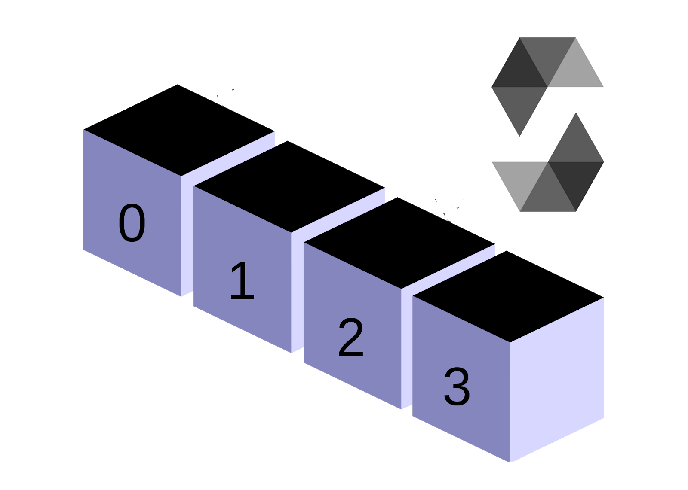
Array literals
You don’t declare the types of variables in JavaScript
JavaScript has array literals, written with brackets and commas
  Example: color = ["red", "yellow", "green", "blue"];
  Arrays are zero-based: color[0] is "red"
If you put two commas in a row, the array has an “empty” element in that location
  Example: color = ["red", , , "green", "blue"];
    color has 5 elements
  However, a single comma at the end is ignored
    Example: color = ["red", , , "green", "blue”,]; still has 5 elements

Slide 20
Four ways to create an array
You can use an array literal:
var colors = ["red", "green", "blue"];
You can use new Array() to create an empty array:
  var colors = new Array();
  You can add elements to the array later:
  colors[0] = "red"; colors[2] = "blue"; colors[1]="green";
You can use new Array(n) with a single numeric argument to create an array of that size
  var colors = new Array(3);
You can use new Array(…) with two or more arguments to create an array containing those values:
  var colors = new Array("red","green", "blue");

Slide 21
The length of an array
If myArray is an array, its length is given by myArray.length
Array length can be changed by assignment beyond the current length
  Example: var myArray = new Array(5); myArray[10] = 3;
Arrays are sparse, that is, space is only allocated for elements that have been assigned a value
  Example: myArray[50000] = 3; is perfectly OK
  But indices must be between 0 and 2³²-1
As in C and Java, there are no two-dimensional arrays; but you can have an array of arrays: myArray[5][3]

Slide 22
Arrays and objects
Arrays are objects
car = { myCar: "Saturn", 7: "Mazda" }
  car[7] is the same as car.7
  car.myCar is the same as car["myCar"]
If you know the name of a property, you can use dot notation: car.myCar
If you don’t know the name of a property, but you have it in a variable (or can compute it), you must use array notation: car.["my" + "Car"]

Slide 23
Array functions
If myArray is an array,
  myArray.sort() sorts the array alphabetically
  myArray.sort(function(a, b) { return a - b; }) sorts numerically
  myArray.reverse() reverses the array elements
  myArray.push(…) adds any number of new elements to the end of the array, and increases the array’s length
  myArray.pop() removes and returns the last element of the array, and decrements the array’s length
  myArray.toString() returns a string containing the values of the array elements, separated by commas

Slide 24
The for…in statement
You can loop through all the properties of an object with for (variable in object) statement;
  Example: for (var prop in course) {
  document.write(prop + ": " + course[prop]);
  }
  Possible output: teacher: Dr. Dave
  number: CIT597
  The properties are accessed in an undefined order
  If you add or delete properties of the object within the loop, it is undefined whether the loop will visit those properties
  Arrays are objects; applied to an array, for…in will visit the “properties” 0, 1, 2, …
  Notice that course["teacher"] is equivalent to course.teacher
    You must use brackets if the property name is in a variable

Slide 25
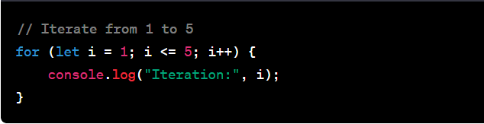

Slide 26
Functions
Functions should be defined in the <head> of an HTML page, to ensure that they are loaded first
The syntax for defining a function is:
function name(arg1, …, argN) { statements }
  The function may contain return value; statements
  Any variables declared within the function are local to it
The syntax for calling a function is just name(arg1, …, argN)
Simple parameters are passed by value, objects are passed by reference

Slide 27
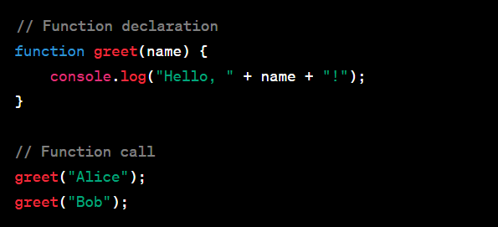
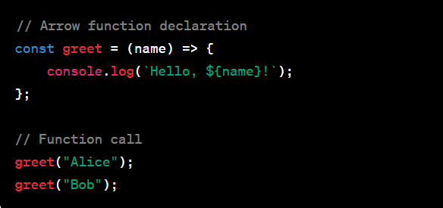

Slide 28
Conclusion
In conclusion, JavaScript stands as a versatile and powerful programming language, crucial for web development. Its ability to enhance user interactions, enable dynamic content, and support a wide range of applications has solidified its role as a cornerstone in the world of programming.
JavaScript's influence extends beyond the browser, with frameworks like React for building dynamic user interfaces and Node.js for server-side development.

Slide 29
Thank you

